Slide 1
ASSIGNMENT
Submitted by
MANUGOPAL V M
ROLL NO : 30

Slide 2
Unit Testing and Integration Testing

Slide 3
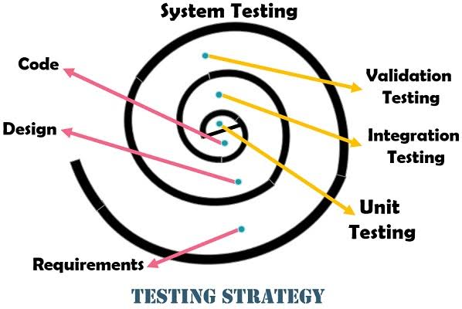
Unit Testing
Concentrates on each component/function of the software as implemented in the source code
Is simplified when a module is designed
with high cohesion
Makes heavy use of testing techniques
that exercise specific paths in a
component‘s control structure to ensure
complete coverage and maximum error
detection
Allows errors to be more easily predicted and uncovered

Slide 4
Integration Testing
When Components are integrated
Focuses on the design and construction of the software
architecture
Focuses on inputs and outputs, and how well the components fit together and work together

Slide 5


Slide 6
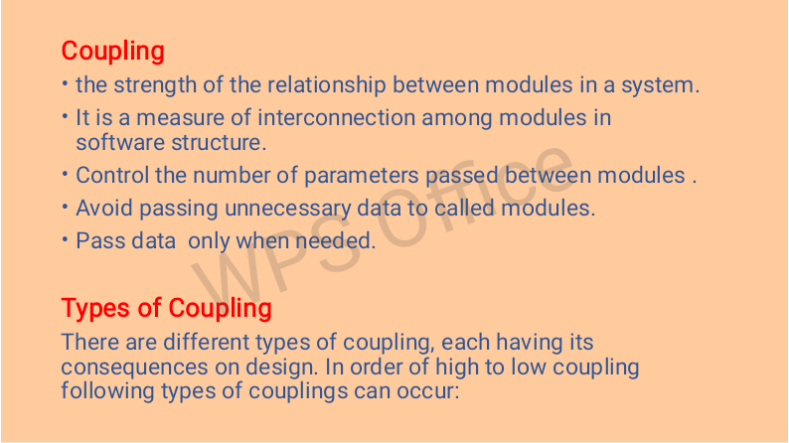

Slide 7
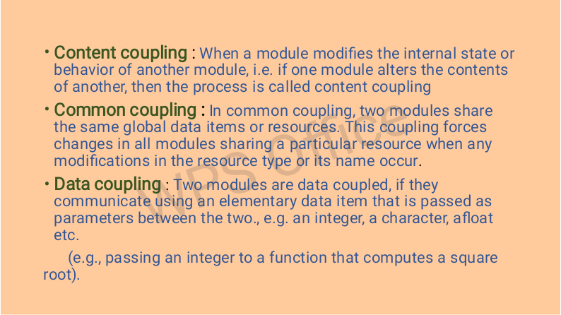

Slide 8


